Slide 1

Threat model
Cybersecurity Internship
Week 10
Intern : Assil Bzal

Slide 2
The code’s functionality
That’s a Python script for automated threat modeling - it takes a description of a system (components + dataflows), analyzes it, and produces:
A STRIDE threat report (in both text and JSON),
A Data Flow Diagram (DFD) using Graphviz, and
A sequence diagram using PlantUML.
Let’s walk through it step-by-step

Slide 3
STRIDE
This tool automates the STRIDE threat modeling process:
STRIDE | Threat Type
S | Spoofing
T | Tampering
R | Repudiation
I | Information Disclosure
D | Denial of Service
E | Elevation of Privilege

Slide 4
Threat generation
This is the heart of the program — it applies heuristic rules to detect threats automatically.
Each rule adds a threat via the add_t() helper.
🔹 Rule 1 — Spoofing / Unauthorized Requests
If external data reaches a destination that doesn’t authenticate sources → spoofing possible.
🔹 Rule 2 — Information Disclosure / Tampering (in-transit)
If a dataflow crosses boundaries and is not encrypted, there’s risk of sniffing or tampering.
🔹 Rule 3 — Unhardened Host Exploitable
If a server/process/datastore is reachable across boundaries but isn’t hardened.
🔹 Rule 4 — Sensitive Data at Rest Exposed
Datastore or server holds sensitive data without hardening/authentication.
🔹 Rule 5 — Lateral Movement to Safety-Critical Bus
If insecure component connects to something safety-critical (like a CAN bus).
🔹 Rule 6 — Denial of Service
Publicly exposed and unhardened services → DoS risk.
🔹 Rule 7 — Injection / Unauthorized Modification
If destination doesn’t sanitize input → injection possible (SQLi, code injection, etc).
Finally, threats are deduplicated before returning.

Slide 5
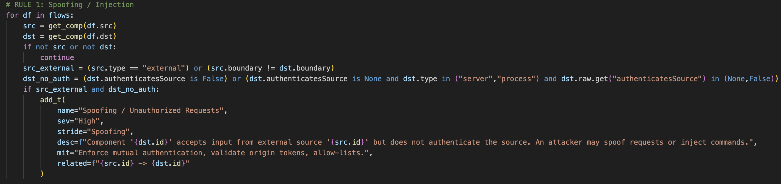
Spoofing

Slide 6
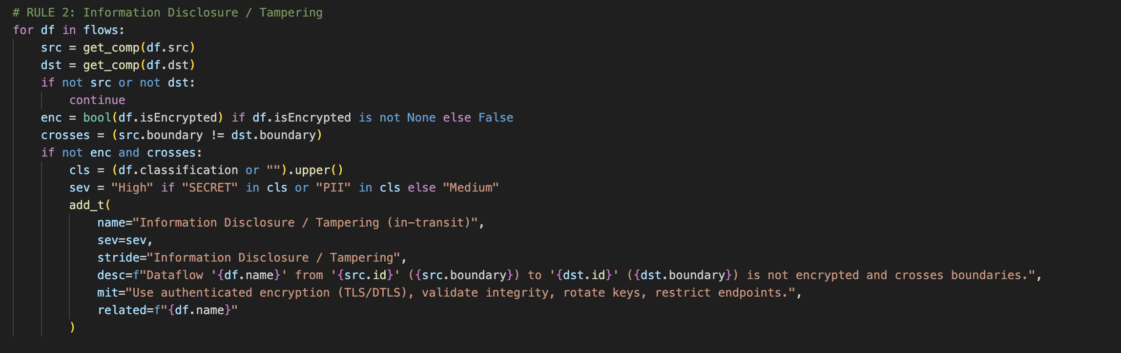
Tampering

Slide 7
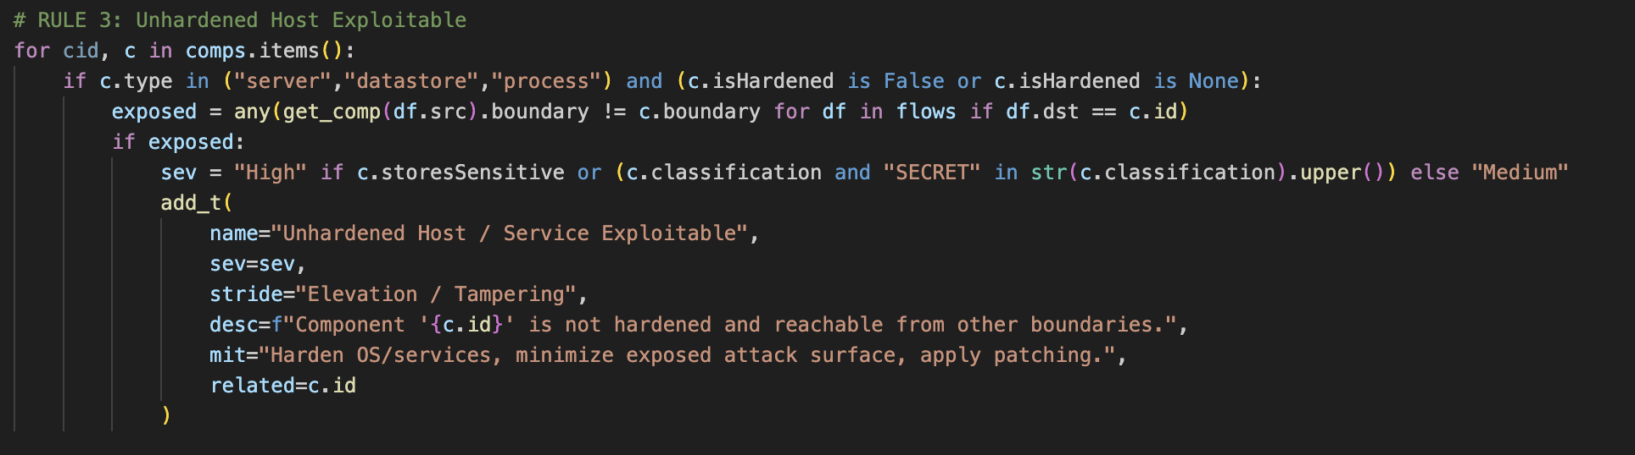
Elevation/tampering
An unhardened host lets an attacker run code or escalate privileges → Elevation of Privilege.
With those privileges they can alter data/configuration → Tampering.

Slide 8
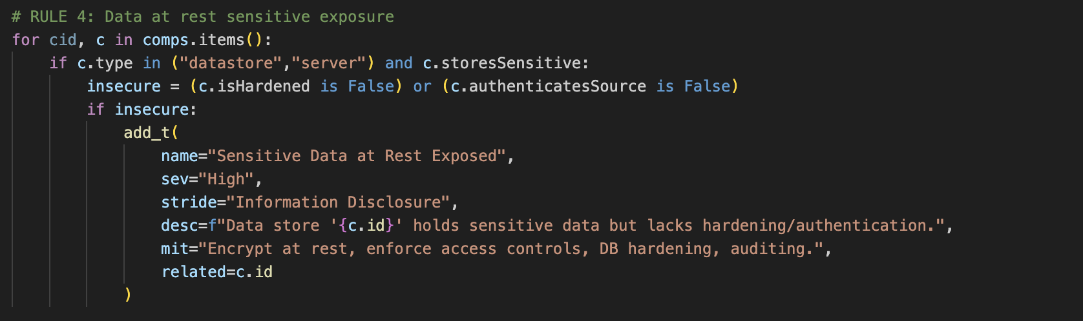
Information disclosure

Slide 9
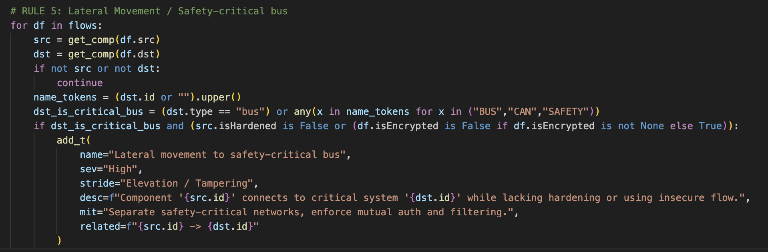
Elevation/tampering

Slide 10
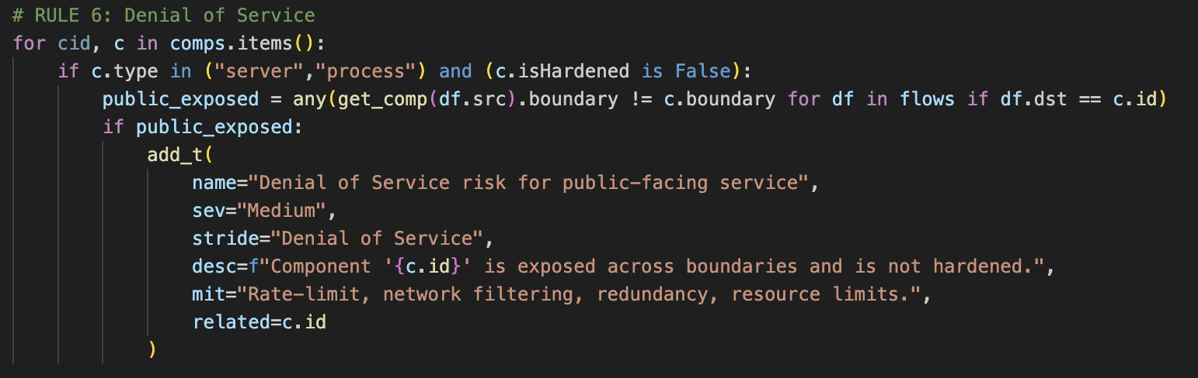
Denial of service

Slide 11
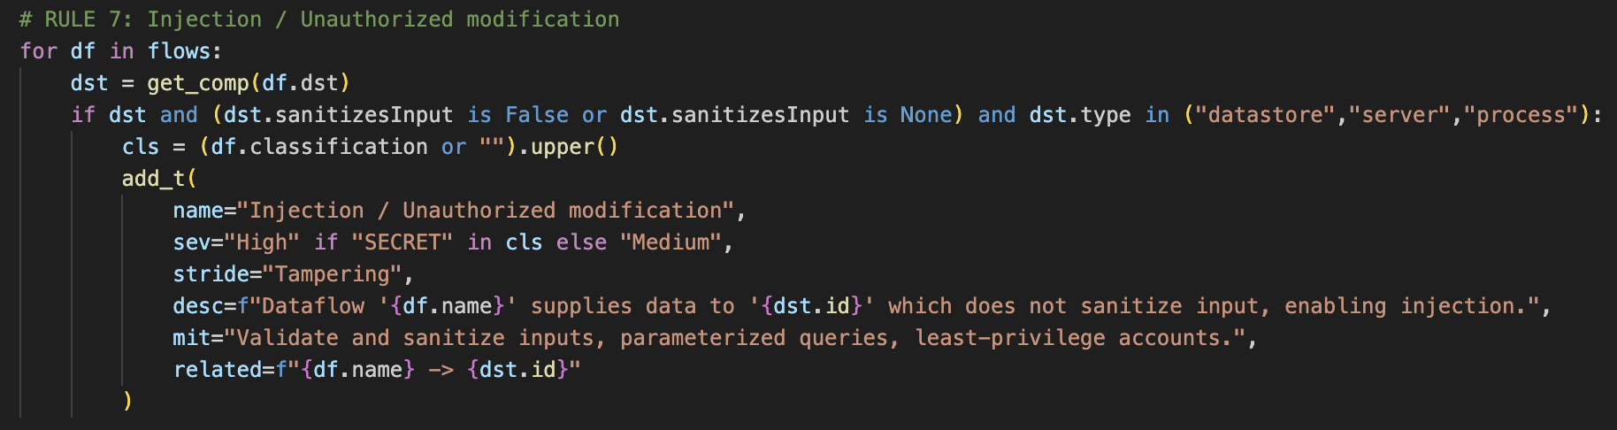
Tampering

Slide 12
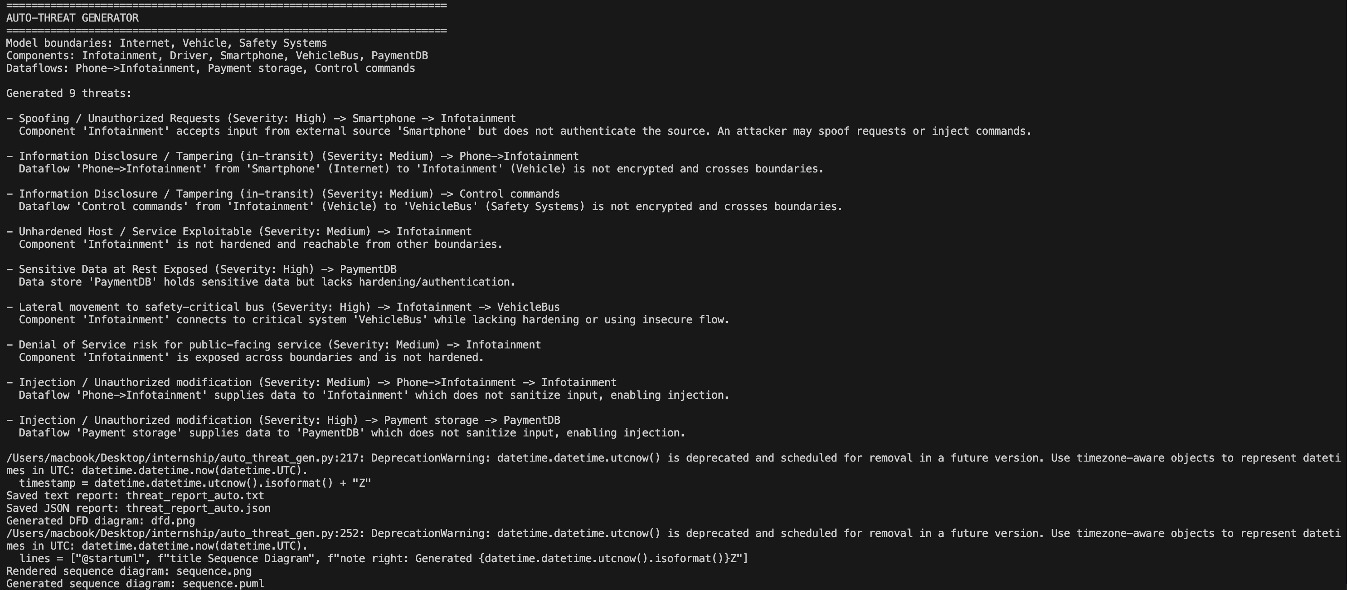
Output

Slide 13
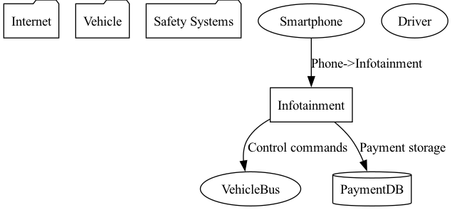
DFD

Slide 14
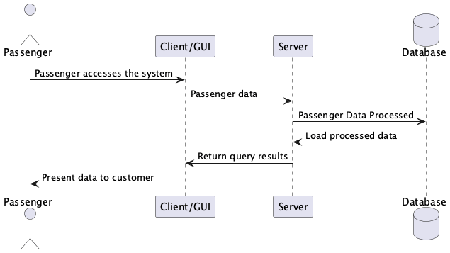
Sequence diagram

Slide 15
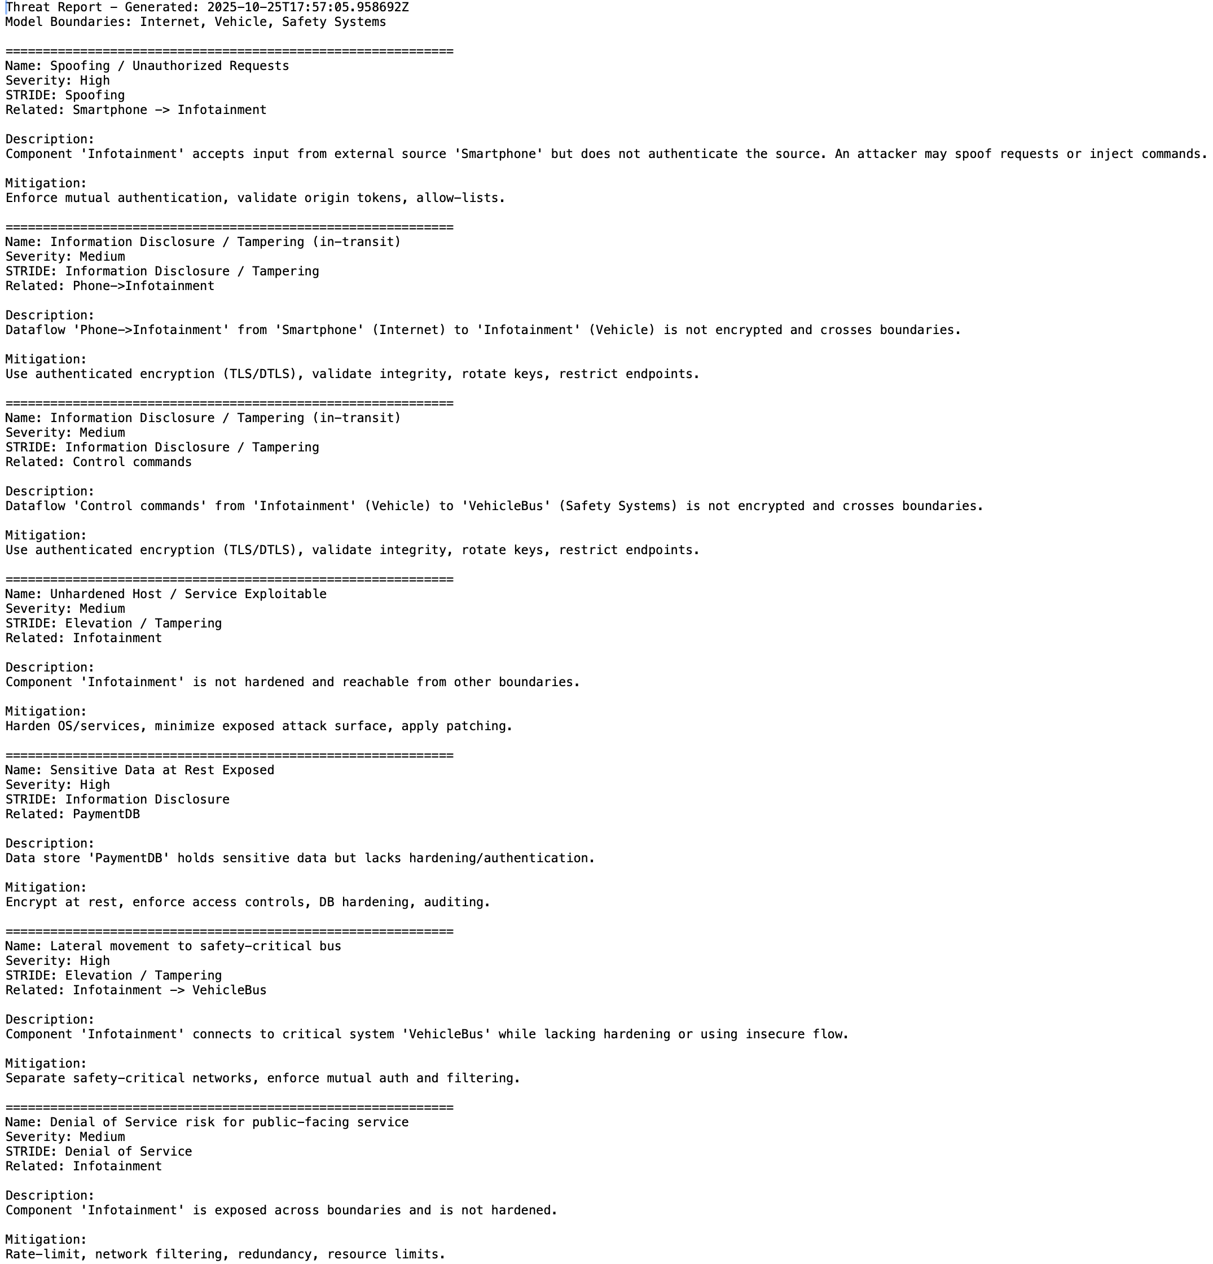
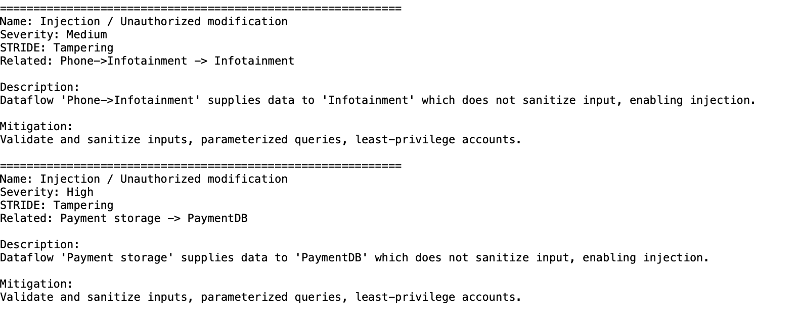
Threat report

